Slide 1
IMPACT OF LAKE-EFFECT SNOW ON TRANSPORTATION NETWORK RESILIENCE IN BUFFALO
Dongyang Wu

Slide 2
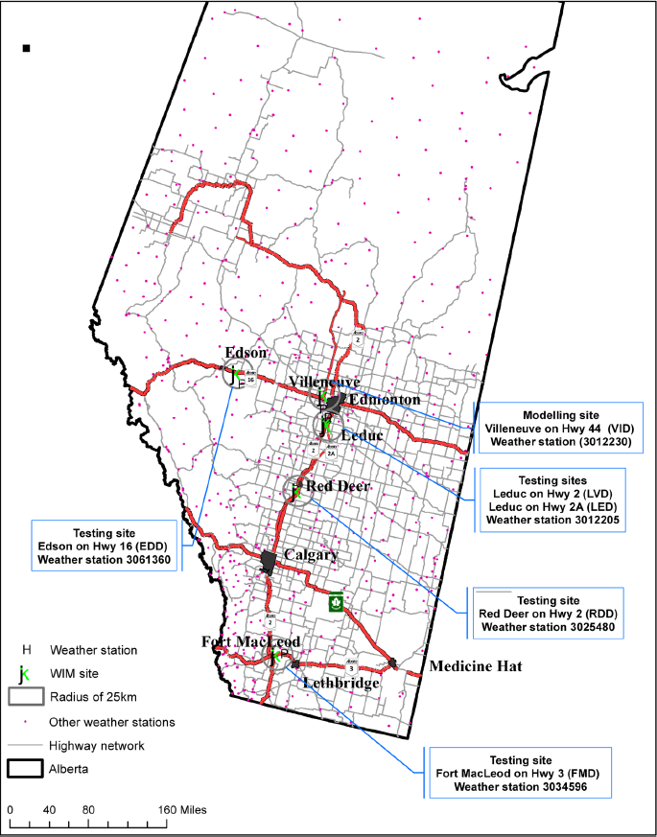
Literature review
Impact of Severe Weather on Traffic Mobility
Hyuk-Jae Roh developed a winter traffic model to assess the impact of severe weather on transportation networks in cold regions. The study demonstrated that temperature and snowfall significantly affect traffic flow, and models can be transferred across different highway segments to optimize monitoring strategies.

Slide 3
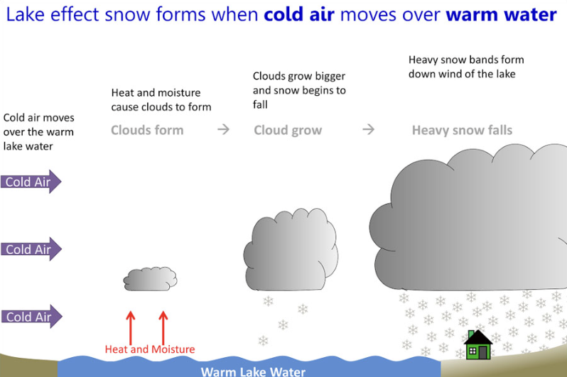
Lake-effect snow in Buffalo
Lake-effect snow
The Buffalo area is often affected by lake-effect snow in winter due to its proximity to the Great Lakes, which leads to extreme snowfall. This weather phenomenon significantly impacts the transportation network, and my research task focuses on analyzing the impact of lake effect snow on traffic flow, speed, and accident rates.

Slide 4
 | Reference paper | My topic
Main focus | Studies the impact of severe winter weather on traffic mobility in cold-region highway networks | Focuses on Lake-Effect Snow and its impact on transportation network resilience in Buffalo
Geographical scope | Conducted in Alberta, Canada across different functionally distinct highway segments | Focused on Buffalo, New York, where Lake Erie contributes heavy snow
Weather factor | General severe winter conditions including cold temperatures and snowfall | Specifically analyzes Lake-Effect Snow
Methodology | Weigh-In-Motion (WIM) traffic data statistical models spatial transferability tests | Local traffic data Historical snowfall records
Outcomes | Winter traffic models can be transferred across different cold regions to optimize monitoring efforts | Identify vulnerable road segments and improve Buffalo’s transportation network

Slide 5
Research tasks and ideas
How do snowfall and low temperatures impact traffic volume, speed, and accident rates?
Which road segments or nodes are most affected during extreme snowfall events?
To what extent does the transportation network's functionality degrade under snowfall conditions?
How resilient is the transportation network, and are there any bottleneck segments?

Slide 6
References
Roh, H.-J. (2024). Modelling severe weather impact on traffic mobility and evaluating cross-regional applicability to functionally distinct segments in cold region highway networks. Sustainable Futures.
National Oceanic and Atmospheric Administration (NOAA). (2023). Lake-Effect Snow in the Great Lakes Region.
Knapp, K. K., & Smithson, L. D. (2000). Winter storm event volume impact analysis using multiple-source archived monitoring data. Transportation Research Record.
Maze, T. H., Agarwal, M., & Burchett, G. D. (2006). Whether weather matters to traffic demand, traffic safety, and traffic operations and flow. Transportation Research Record.

Slide 7


